Slide 1
One Public Transport System for Cornwall
Nigel Blackler
Head of Strategy, Economy, Enterprise and Environment

Slide 3
Rail in Cornwall

Slide 4
Buses in Cornwall

Slide 5
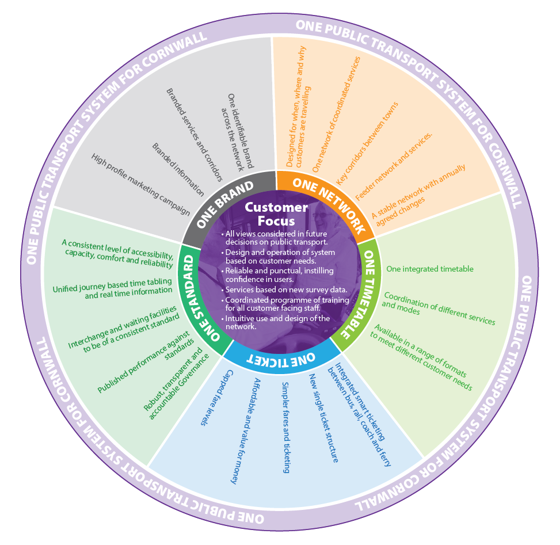
One Public Transport System for Cornwall

